Slide 1
RNA-seq data analysis (I)
Haibo Liu
Iowa State University

Slide 2
Treating Bioinformatics as a Data Science
Seven stages to data science
1. Define the question of interest
2. Get the data
3. Clean the data
4. Explore the data
5. Fit statistical models
6. Communicate the results
7. Make your analysis reproducible

Slide 3
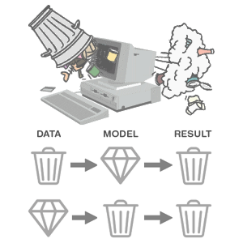
Avoid Garbage In, Garbage Out
(https://thedailyomnivore.net/2015/12/02/garbage-in-garbage-out/)

Slide 4
Bioinformatician should NOT JUST be a data scientist!!!

Slide 5
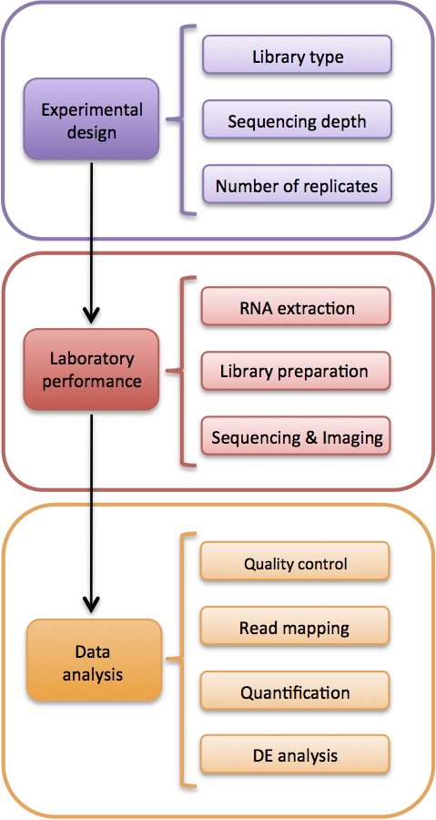
Bioinformatician’s role at stages of RNA-seq experiments
Coherent/robust experimental design: groundwork of a successful experiment, avoiding unusable data and wasted time, money, and effort
Consult a data analyst or bioinformatician!!!
Inform experimenter/ sequencing facility of experimental design
Library prep batch
Layout of library on lane/flow cell
Analyst aware of experimental design:
Quality control
Statistical model selection
…

Slide 6
Outline
Overview of RNA-seq
Experimental design
Data generation
Sample preparation
Library preparation
Sequencing
Data analysis
Sample level analysis
Gene level analysis
Advanced analysis

Slide 7
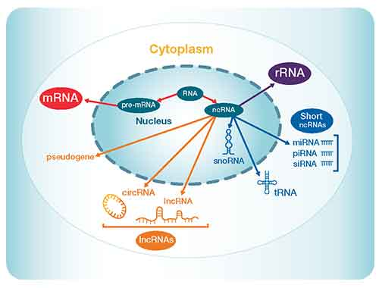
Transcriptome
Transcriptome:
Broadly speaking, all RNAs transcribed whether from a single cell or a population of cells
Narrowly speaking, the total mRNA, with a focus on gene expression and what is being specifically coded for proteins
Palazzo AF, Lee ES. Front Genet 6:2 (2015)

Slide 8
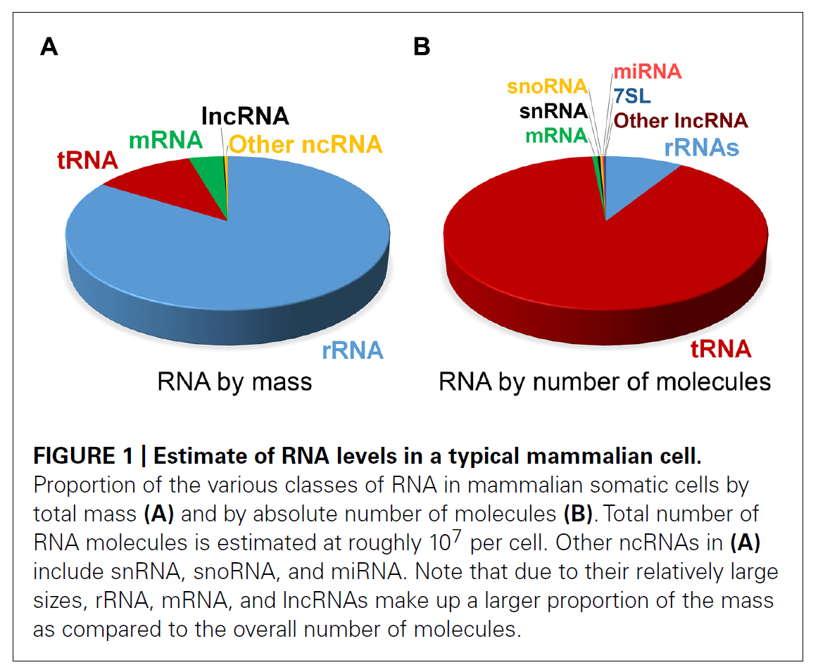
RNA contents in a typical Eukaryotic cells
Palazzo AF, Lee ES. Front Genet 6:2 (2015)

Slide 9
What is RNA-seq?
RNA-seq (RNA-sequencing) is a technique that can examine the quantity and sequences of RNA in a sample using next generation sequencing (NGS).
It analyzes the gene expression patterns encoded within a transcriptome.

Slide 10
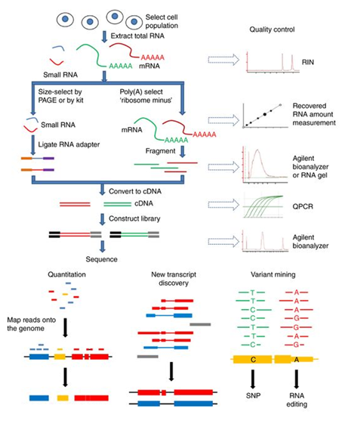
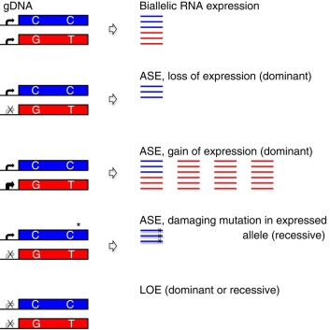
RNA-seq and its applications
…
Allele-specific expression
Calculate read counts, TPM
4
1
3

Slide 11
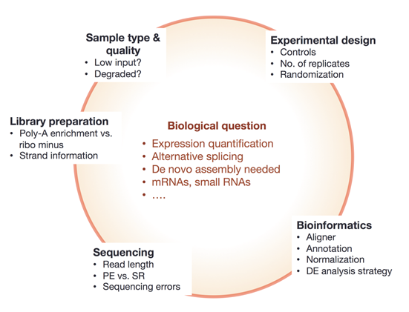
RNA-seq is a complex process, where everything is connected!!
The Everything's connected slide by Dündar et al. (2015)

Slide 12
Outline
Overview of RNA-seq
Experimental design
Data generation
Sample preparation
Library preparation
Sequencing
Data analysis
Sample level analysis
Gene level analysis
Advanced analysis

Slide 13
Experimental design is critical
“…, the planning and design of RNA-Seq experiments has important implications for addressing the desired biological question and maximizing the value of the data obtained.”
--Aniruddha Chatterjee
Chatterjee et al. (2018) A Guide for Designing and Analyzing RNA-Seq Data. In: Raghavachari N., Garcia-Reyero N. (eds) Gene Expression Analysis. Methods in Molecular Biology, vol 1783. Humana Press, New York, NY

Slide 14
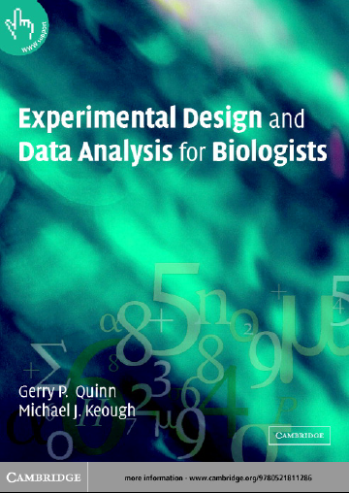
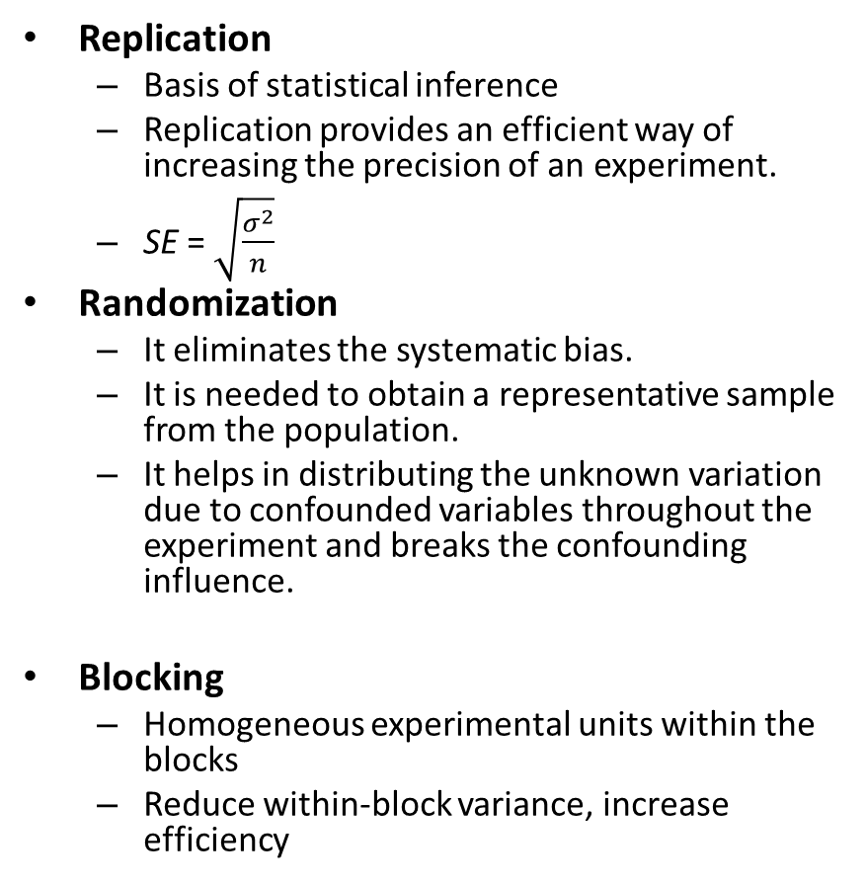
Three critical principles in experimental design
Replication
Basis of statistical inference
Replication provides an efficient way of increasing the precision of an experiment.
SE = $\sqrt{\frac{σ^{2}}{n}}$
Randomization
It eliminates the systematic bias.
It is needed to obtain a representative sample from the population.
It helps in distributing the unknown variation due to confounded variables throughout the experiment and breaks the confounding influence.
Blocking
Homogeneous experimental units within the blocks
Reduce within-block variance, increase efficiency

Slide 15
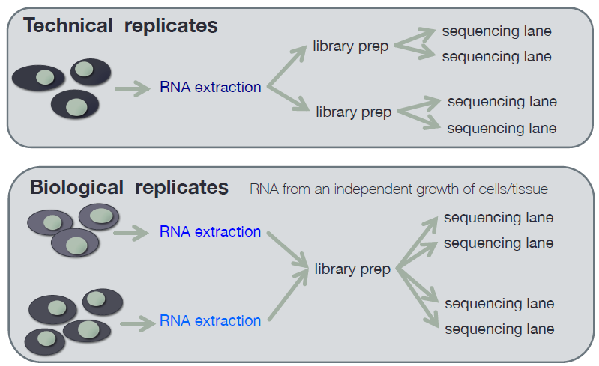
Vocabulary-Biological and technical replicates
Samples that have been obtained from biologically separate samples.
different individual organisms
different samplings of the same tumor
different population of cells grown separately from each other but originating from the same cell-line.
A biological replicate combines both technical and biological variability as it is also an independent case of all the technical steps.
Also see Blainey et al. Nat Methods 11, 879–880 (2014) doi:10.1038/nmeth.3091

Slide 16
Vocabulary-Statistical power
The ability to identify differentially expressed genes when there really is a difference.
This is partly dependent on variance and therefore is affected by the number of replicates available and sequencing depth.
See Krzywinski, M., Altman, N. Power and sample size. Nat Methods 10, 1139–1140 (2013) doi:10.1038/nmeth.2738

Slide 17
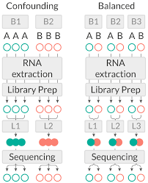
Vocabulary-Confounding factors
A confounding factor is a nuisance variable that is associated with the factor of interest.
Possible confounding factors should be controlled for so they don't interfere with analysis.

Slide 18
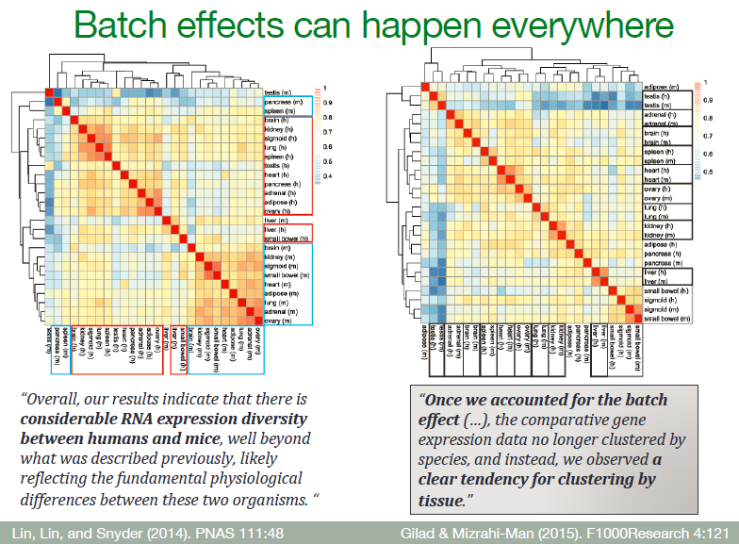

Slide 19


Biological and technical variance
Observed gene expr. variance
Biological variance
$$=$$
$$+$$
Technical variance
Biological replicates measure combined biological and technical variability
Biological variability is the main source of variability
Natural variation (Genetic and stochastic) in the population and within cells.
The amount of variance between your biological replicates will affect the outcome of your analysis. Ideally, you aim to have minimal variability between samples so you only measure the effect of the condition of interest.
Technical variation:
Mainly from RNA processing + library prep
flow cells or lane effect is usually small
Generally, creating technical replicates is unnecessary.

Slide 20
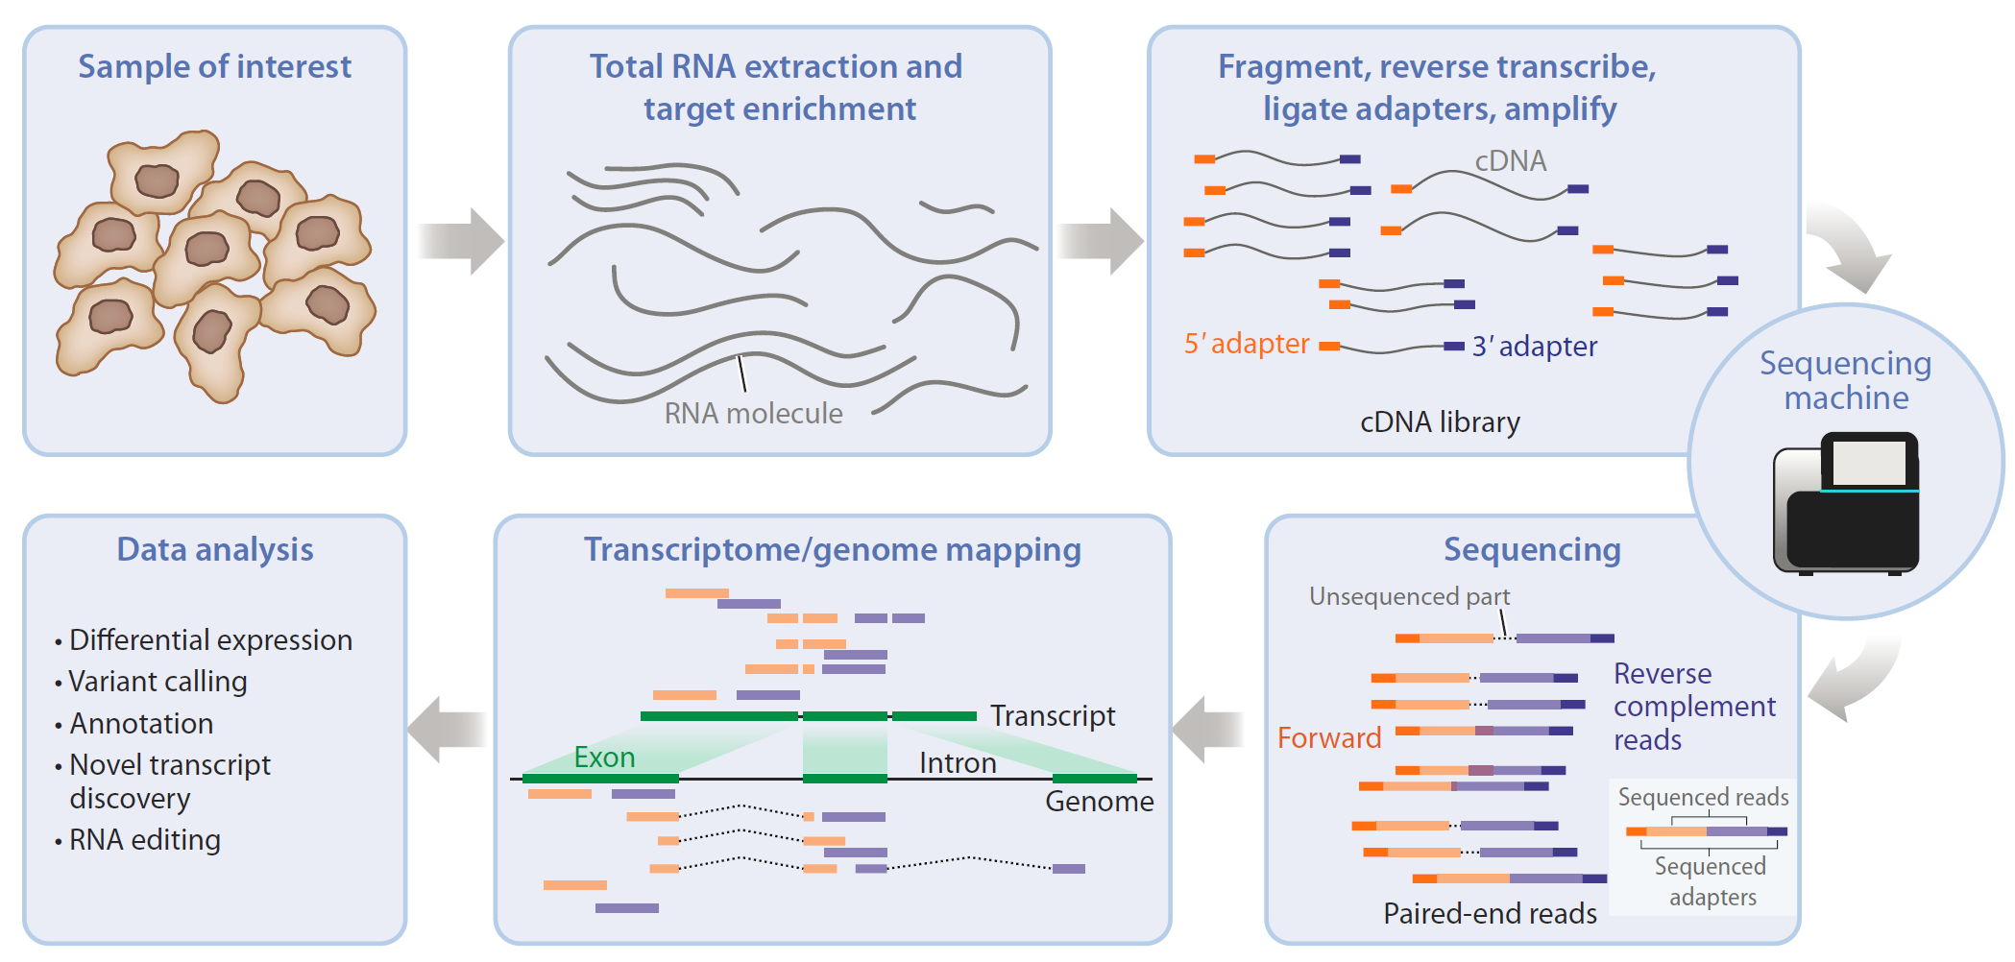
Sources and size of variability in RNA-seq
Biological variability
Technical variability
Biggest
Big
Big
Very small
(Van de Berge et al. Annu. Rev. Biomed. Data Sci. 2019. 2:139–73)

Slide 21
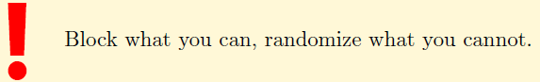
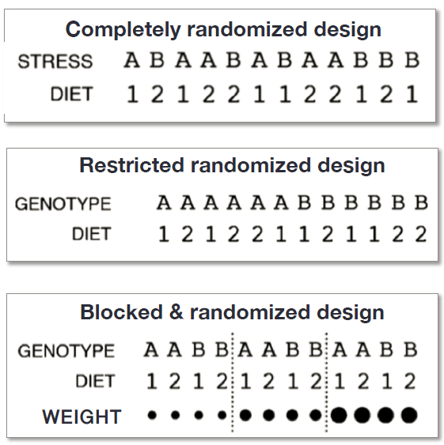
Strategies to minimize variation between samples and to control confounding variables
Choosing organisms of similar genetic background (littermates)
Choosing organisms of the same sex if possible
Using a constant sample collection time and sampling sites on tissues.
Having the same laboratory technician perform RNA prep and library prep, same lots of reagents, limit processing time range
If variation between samples can not be removed, use balanced blocking design and modeling the block effect during analysis
Randomizing samples to prevent a confounding batch effect if all samples can't be processed at one time.
Krzywinski and Altman. Nat Methods 11, 699–700 (2014) doi:10.1038/nmeth.3005

Slide 22
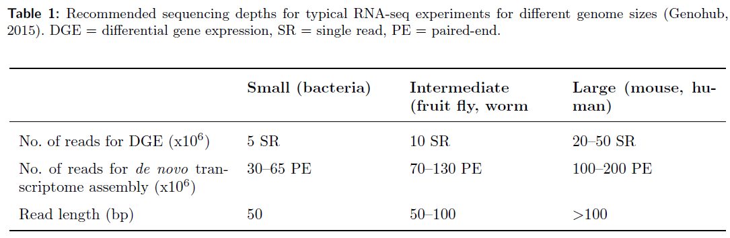
Number of Replicates and Sequencing reads
As a general rule, the number of biological replicates should never be below 3 (ideally, 6 replicates).
For a basic RNA-seq differential expression experiment, 10M to 20M reads per sample is usually enough. Do consider the transcriptome complexity.
More replicates are often better investments than deeper sequencing
Biological variability is usually the largest effect limiting the power of RNA-seq analysis
Scotty – A web-based tool for Power Analysis for RNA Seq Experiments: http://scotty.genetics.utah.edu/

Slide 23
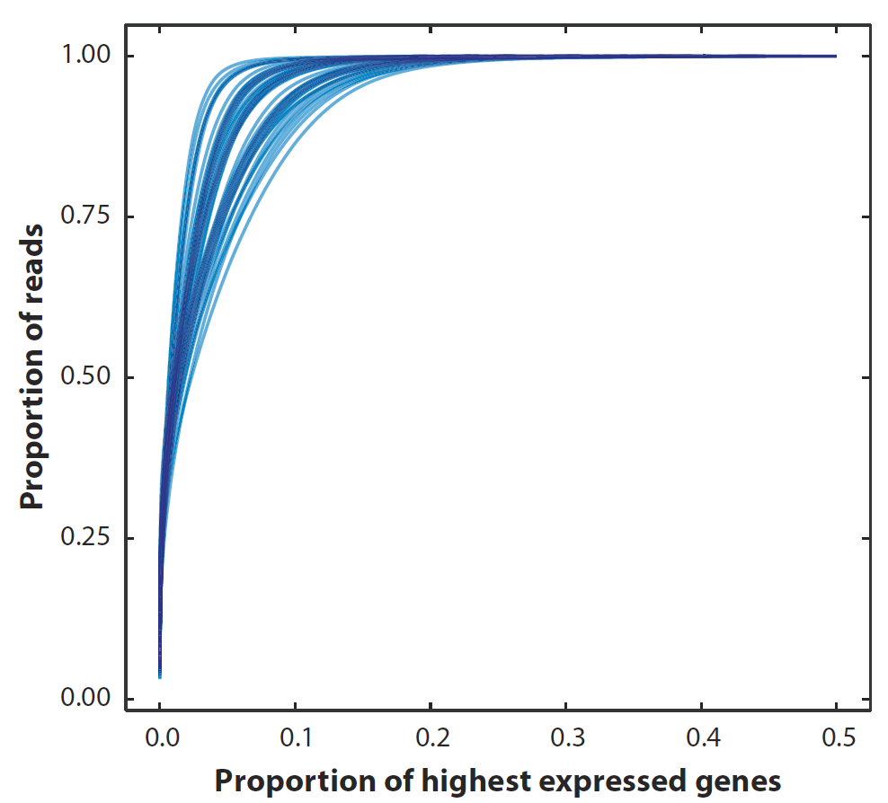
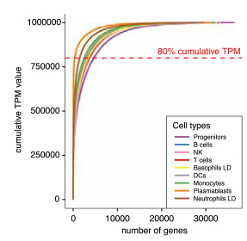
Sequencing depth vs. replicates
Once fragments > 10 M, further increasing sequencing only marginally increases the number of lowly expressed genes detected, but statistical power to detect DE does not improve considerably.
In most cases, increasing replicates is more beneficial than increasing sequencing depth. CAUTION: weight library prep cost vs. sequencing cost!!.
0.80
(Van de Berge et al. Annu. Rev. Biomed. Data Sci. 2019. 2:139–73)
(Monaco et al. 2019, Cell Reports 26, 1627-1640)

Slide 24
Sequencing options to consider
Quality and quantity of total RNA
100 ~250 ng total RNA per sample
RIN > 7.0 (adjust for RIN in models) RNA enrichment method
Poly-A enrichment (minimum of 100ng)
recommended for most standard RNA-seq experiments
provide no information about microRNAs and other non-coding RNA species
rRNA depeletion (minimum of 200ng)
more noisy
recommended for poor or variable quality of RNA
Read type and read length
Single end: recommended for basic DEG analysis
Paired end: recommended for transcriptome assembly
50-100 bp SE for counting; 100-150 bp PE for transcript reconstruction
Applications that require more, longer, and possibly paired-end reads:
• quantification of lowly expressed genes
• identification of genes with small changes between conditions
• investigation of alternative splicing/isoform quantification
• identification of novel transcripts, chimeric transcripts
• de novo transcriptome assembly
Strandedness
Non-stranded: recommended for basic RNA-seq experiments
Stranded: novel transcript discovery, more accurate quantitation
Multiplexing: minimize lane effect
Spike-in controls:
Have been used for normalization and quality control
Recent work has shown that the amount of technical variability in their use dramatically reduces their utility. (not recommended, Risso et al. Nature Biotechnology, 2014, 1-10
(https://www.melbournebioinformatics.org.au/tutorials/tutorials/rna_seq_exp_design/rna_seq_experimental_design/)

Slide 25
Outline
Overview of RNA-seq
Experimental design
Data generation
Sample preparation
Library preparation
Sequencing
Data analysis
Sample level analysis
Gene level analysis
Advanced analysis

Slide 26
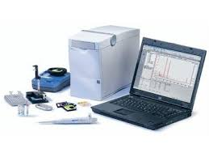
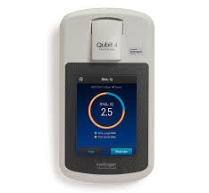
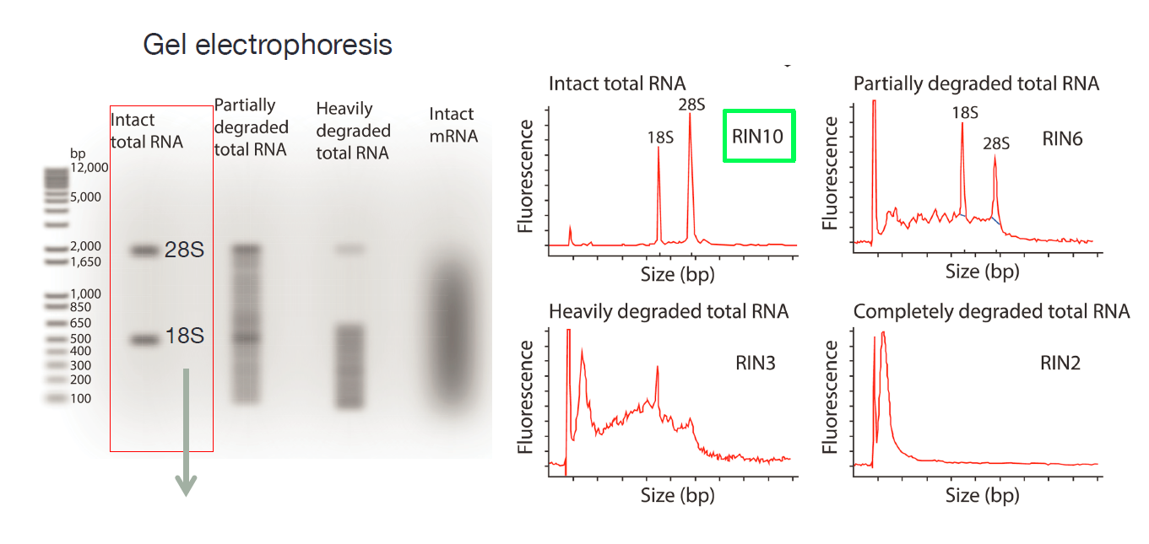
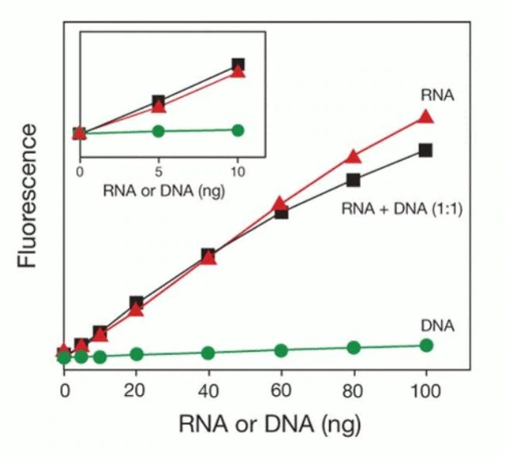
RNA quantity and quality (RIN) determines choice of library preparation protocols
Schroeder et al. The RIN: an RNA integrity number for assigning integrity values to RNA measurements.
BMC Molecular Biol 7, 3 (2006) doi:10.1186/1471-2199-7-3

Slide 27
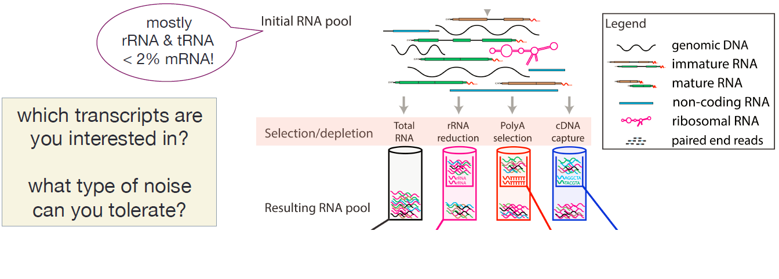
Choices of mRNA enrichment methods
Quality of initial RNA

Slide 28
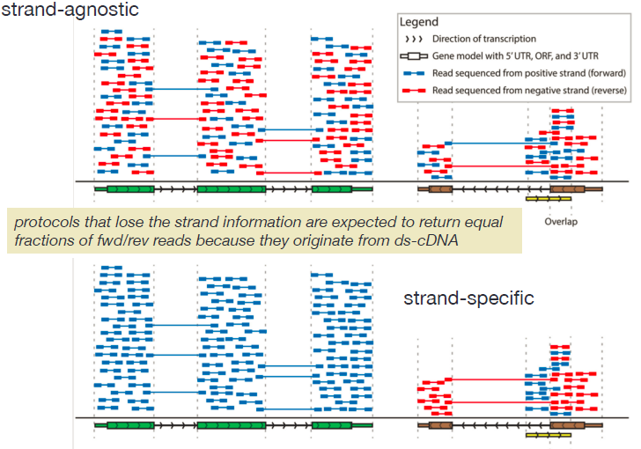
Stranded vs. unstranded RNA-seq

Slide 29
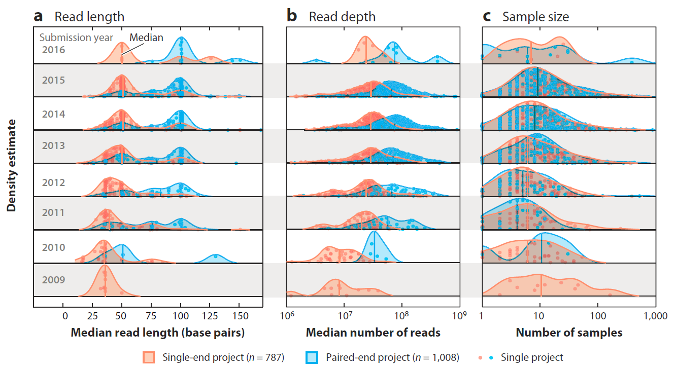
Trends of read length, depth, and sample size of RNA-seq experiments
(Van de Berge et al. Annu. Rev. Biomed. Data Sci. 2019. 2:139–73)

Slide 30
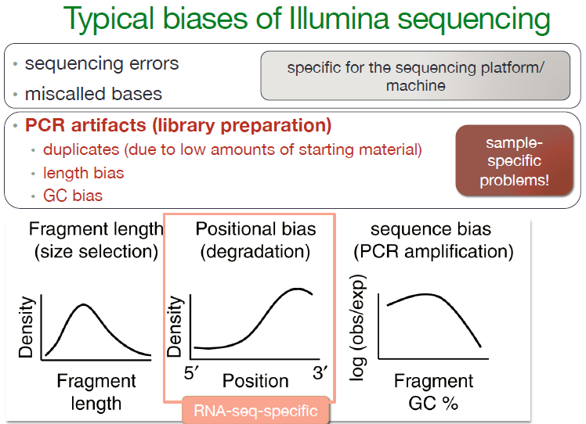

Slide 31
General biases
Issues with using reference genome
CNV
Mappability
Mapping ambiguity
Multi-mapping reads

Slide 32
Outline
Overview of RNA-seq
Experimental design
Data generation
Sample preparation
Library preparation
Sequencing
Data analysis
Sample level analysis
Gene level analysis
Advanced analysis

Slide 33
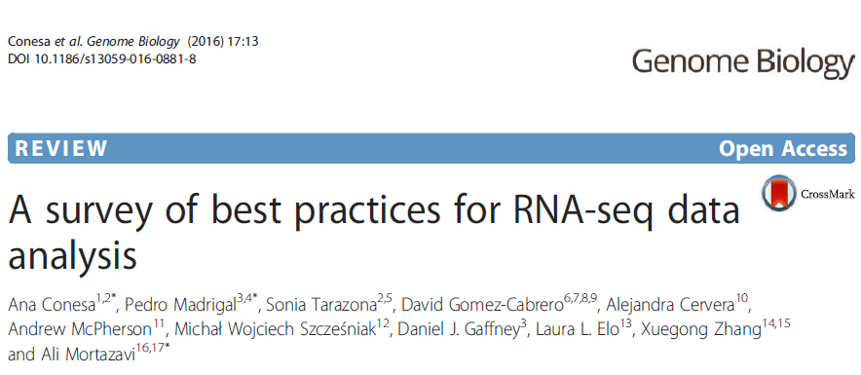
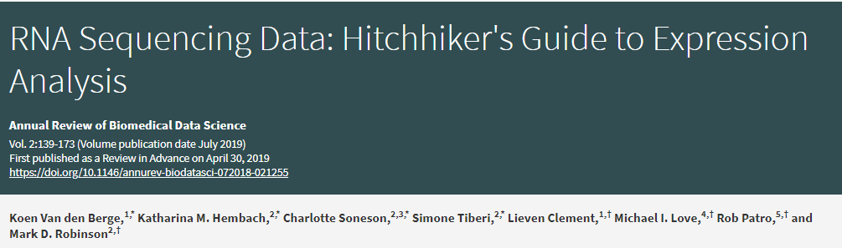
Best practices on RNA-seq data analysis
https://link.springer.com/protocol/10.1007%2F978-1-4939-7834-2_11

Slide 34
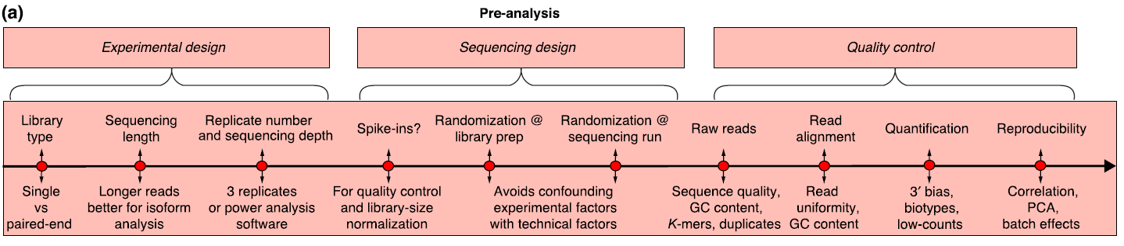
Pre-analysis
FASTQC
MultiQC
QoRTs
R
Conesa et al. Genome Biology (2016) 17:13

Slide 35
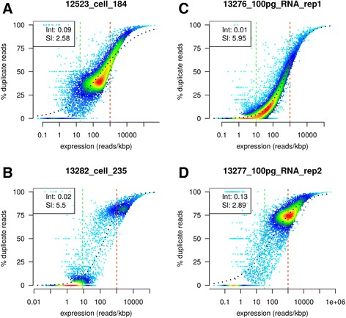
Quality control of RNA-seq data
Tools for RNA-seq data QC:
pre-alignment QC: fastq files as input
FASTQC and MultiQC
Post-alignment QC: bam files as input
QoRTs (httpToos://hartleys.github.io/QoRTs/): best
RSeqQC (http://rseqc.sourceforge.net/)
RNA-SeQC (https://software.broadinstitute.org/cancer/cga/rna-seqc)
dupRadar (https://www.ncbi.nlm.nih.gov/pubmed/27769170): duplication check specific to RNA-seq data
Post-quantitation QC: expression matrix as input
Sample correlation, clustering and PCA analysis using R
(Sayols et al. BMC Bioinformatics. 2016; 17: 428.)

Slide 36
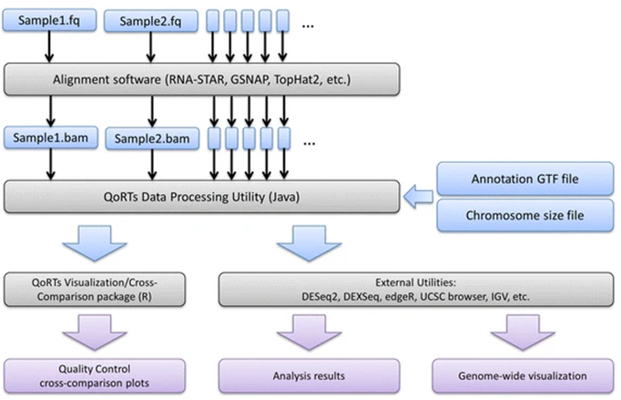
QoRTs analysis pipeline
Hartley and Mullikin. BMC Bioinformatics 16, 224 (2015) doi:10.1186/s12859-015-0670-5

Slide 37
Sequencing data quality improvement (optional)
Trimming low-quality bases and adapters: Trimmomatic
Using relaxed trimming thresholds
Improve mappability
Reduce mapping artifacts
Error correction: Rcorrector
Improve mappability
Improve de novo transcriptome assembly
For more tools, see https://en.wikipedia.org/wiki/List_of_RNA-Seq_bioinformatics_tools#Error_correction.

Slide 38
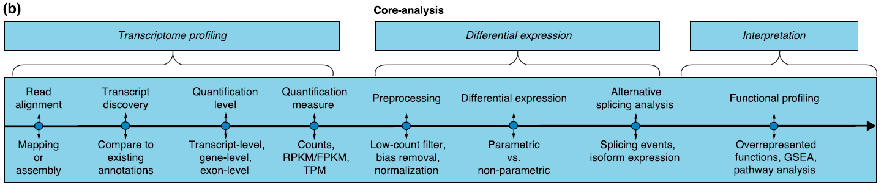
Core Analysis
CPM
Conesa et al. Genome Biology (2016) 17:13

Slide 39
Alignment and Quantification

Slide 40
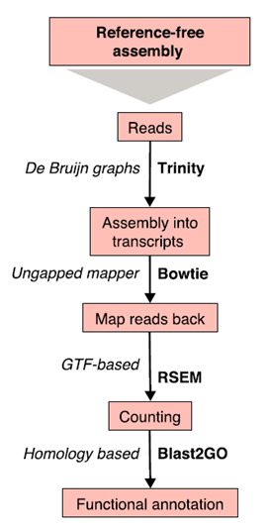
Case I: No reference genome No reference transcriptome
Start with de novo transcriptome assembly
Conesa et al. Genome Biology (2016) 17:13

Slide 41
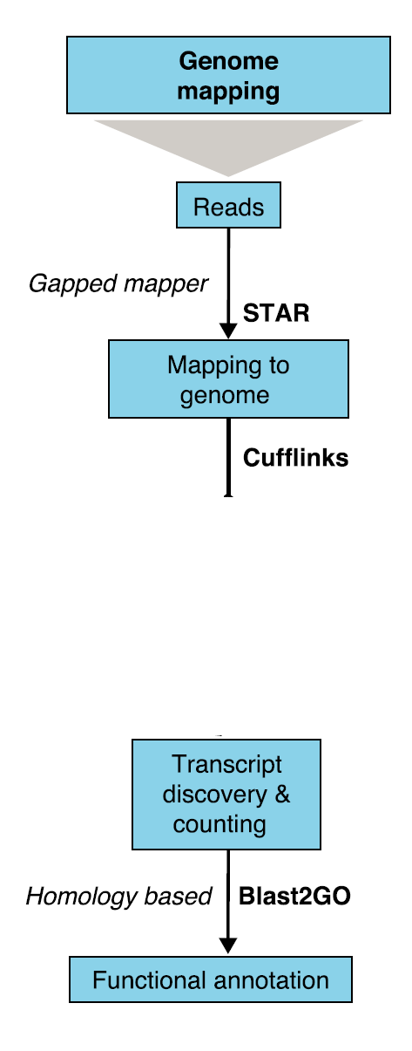
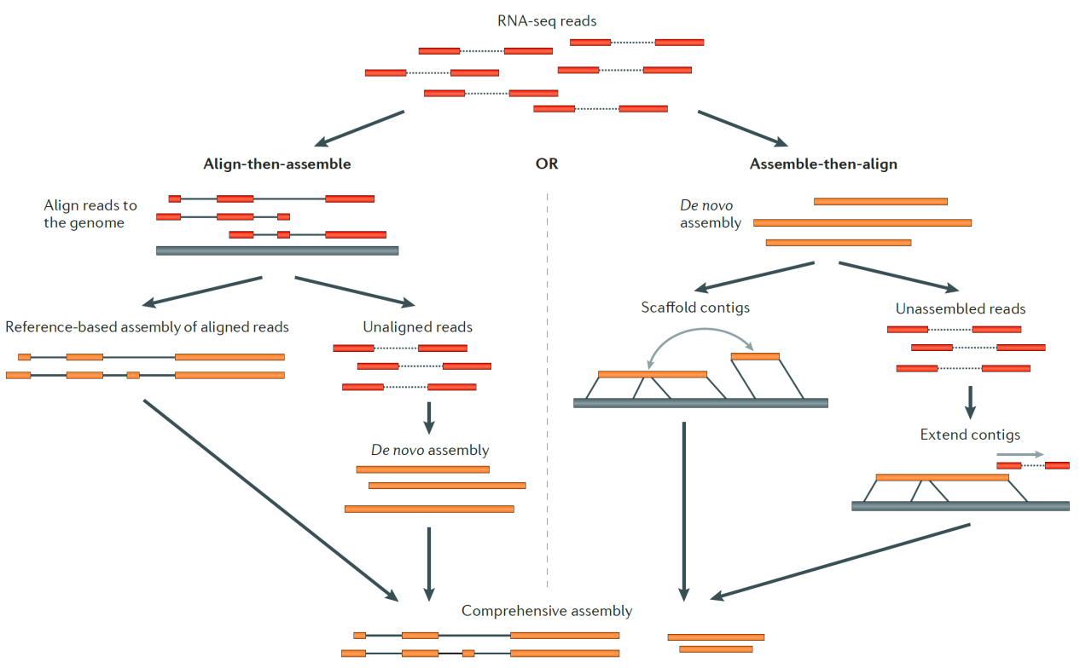
Case II: reference genome but not well annotated
de novo transcriptome assembly
genome guided transcriptome assembly
Hybrid transcriptome assembly
HISAT
GMAP
Trinity
StringTie
TransComb
Transcriptome assembly
Bowtie
RSEM
Martin and Wang. Nature Reviews Genetics 2011(12): 671–682
Conesa et al. Genome Biology (2016) 17:13

Slide 42
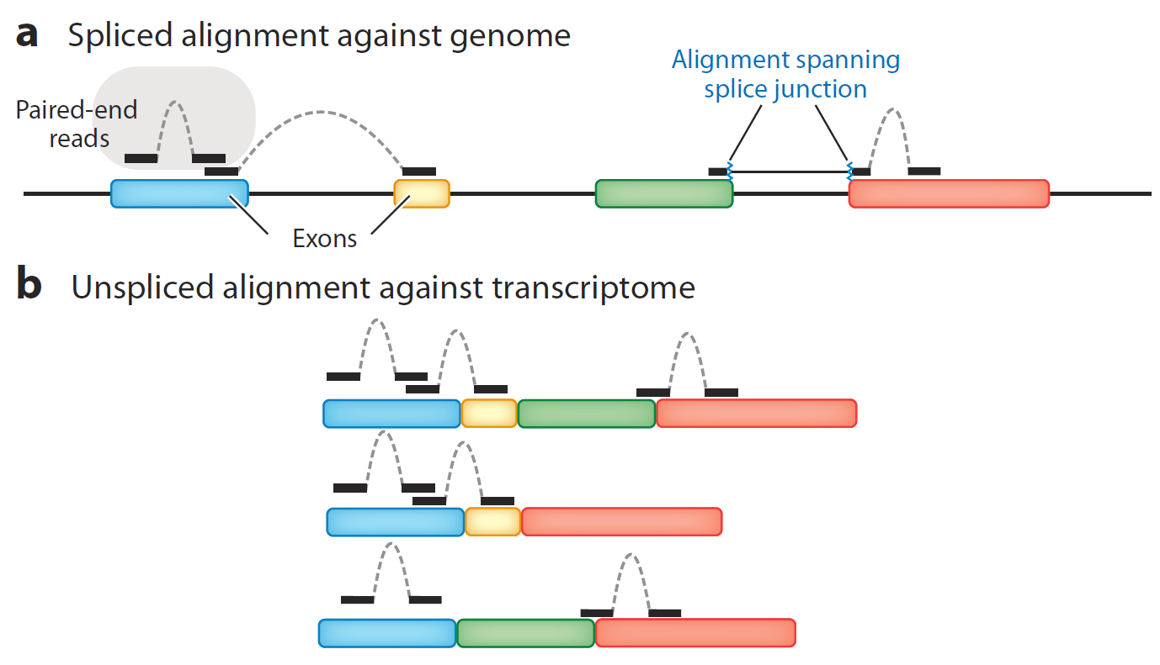
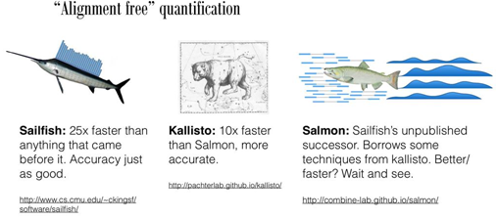
Case III: reference genome well enough annotated
Using Splice-aware aligner: STAR, HISAT2, GMAP
Using ungapped aligner: Bowtie
(Van de Berge et al. Annu. Rev. Biomed. Data Sci. 2019. 2:139–73)
C. Alignment free or Pseudo-alignment against transcriptome: Salmon, Sailfish, Kallisto
EM algorithms
Sailfish: k-mer-based approaches
Kallisto: pseudo-alignment
Salmon: quasi-alignment, modeling GC-bias
(Cyverse)

Slide 43
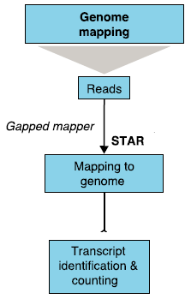
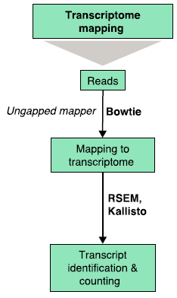
Case III: reference genome well enough annotated
HISAT
GMAP
Pseudo-mapping to transcriptome
Pseudo-aligner
Sailfish, Salmon, Kallisto
GTF/GFF
featureCounts
Sailfish
Salmon
Conesa et al. Genome Biology (2016) 17:13

Slide 44
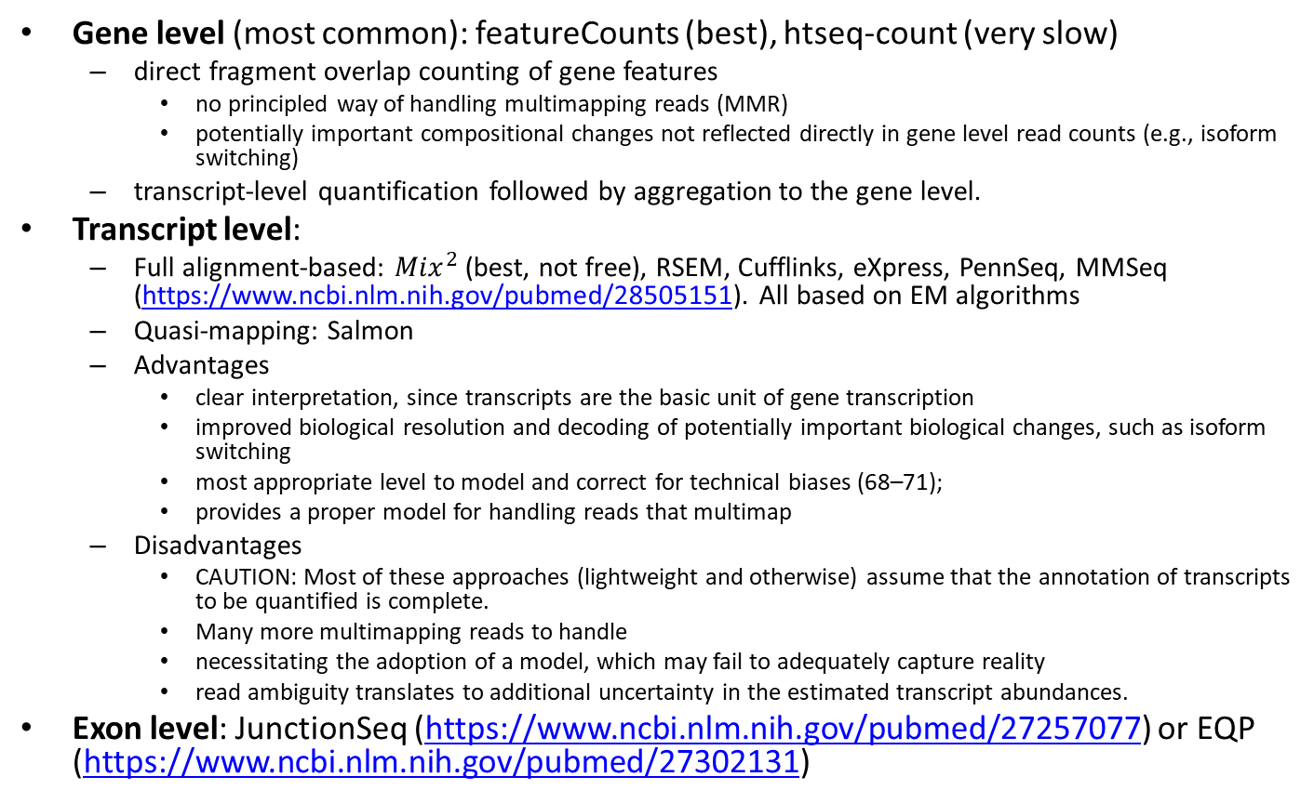
Expression quantification at different levels
Gene level (most common): featureCounts (best), htseq-count (very slow)
direct fragment overlap counting of gene features
no principled way of handling multimapping reads (MMR)
potentially important compositional changes not reflected directly in gene level read counts (e.g., isoform switching)
transcript-level quantification followed by aggregation to the gene level.
Transcript level:
Full alignment-based: ${Mix}^{2}$ (best, not free), RSEM, Cufflinks, eXpress, PennSeq, MMSeq (https://www.ncbi.nlm.nih.gov/pubmed/28505151). All based on EM algorithms
Quasi-mapping: Salmon
Advantages
clear interpretation, since transcripts are the basic unit of gene transcription
improved biological resolution and decoding of potentially important biological changes, such as isoform switching
most appropriate level to model and correct for technical biases (68–71);
provides a proper model for handling reads that multimap
Disadvantages
CAUTION: Most of these approaches (lightweight and otherwise) assume that the annotation of transcripts to be quantified is complete.
Many more multimapping reads to handle
necessitating the adoption of a model, which may fail to adequately capture reality
read ambiguity translates to additional uncertainty in the estimated transcript abundances.
Exon level: JunctionSeq (https://www.ncbi.nlm.nih.gov/pubmed/27257077) or EQP (https://www.ncbi.nlm.nih.gov/pubmed/27302131)

Slide 45
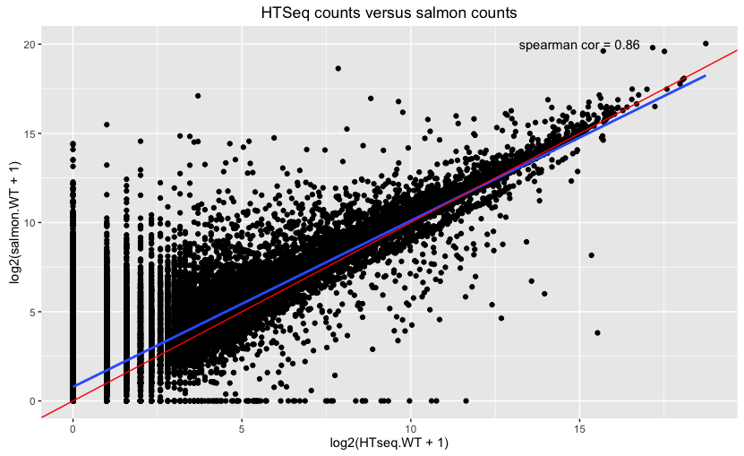
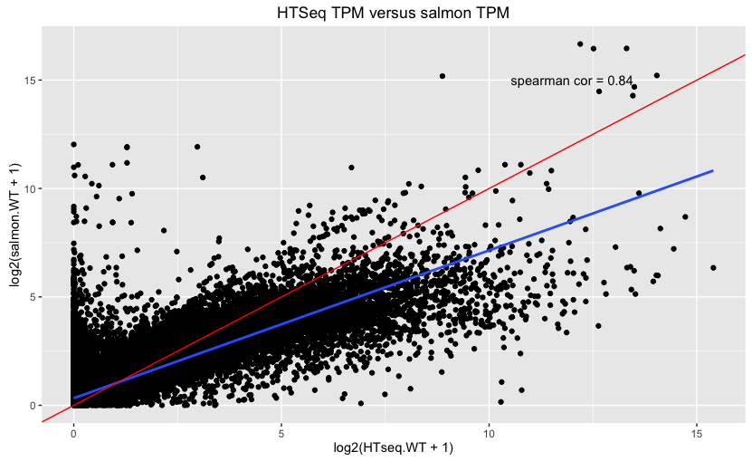
Salmon versus HTseq counting
https://cgatoxford.wordpress.com/2016/08/17/why-you-should-stop-using-featurecounts-htseq-or-cufflinks2-and-start-using-kallisto-salmon-or-sailfish/
http://crazyhottommy.blogspot.com/2016/07/comparing-salmon-kalliso-and-star-htseq.html
https://www.biorxiv.org/content/biorxiv/early/2018/10/16/444620.full.pdf
Soneson et al. F1000Research 2016, 4:1521 Last updated: 12 NOV 2019, https://doi.org/10.12688/f1000research.7563.2

Slide 46
Recommendations on quantitation
Gene abundance estimates are more accurate than transcript abundance estimates
DTE is more powerful and easier to interpret on gene level than for individual transcripts
Incorporating transcript-level estimates leads to more accurate DGE results

Slide 47
Preprocessing of quantitation data

Slide 48
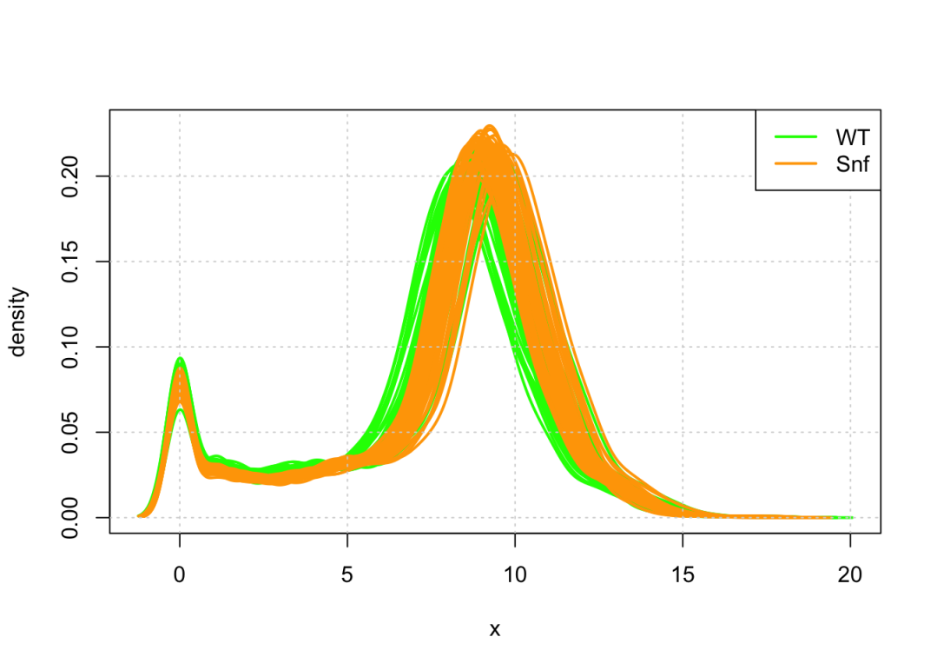
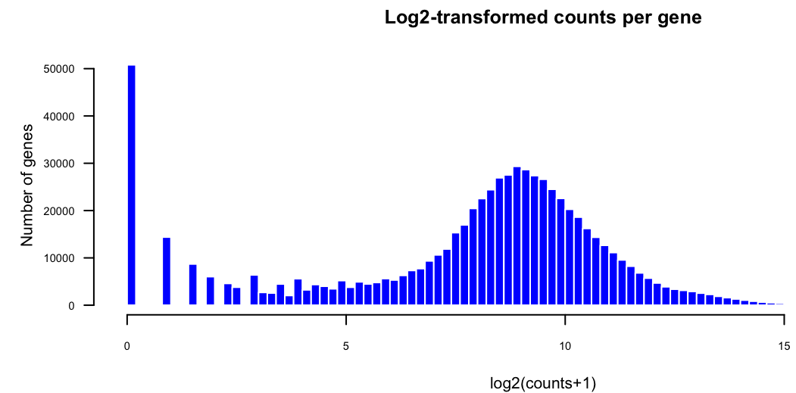
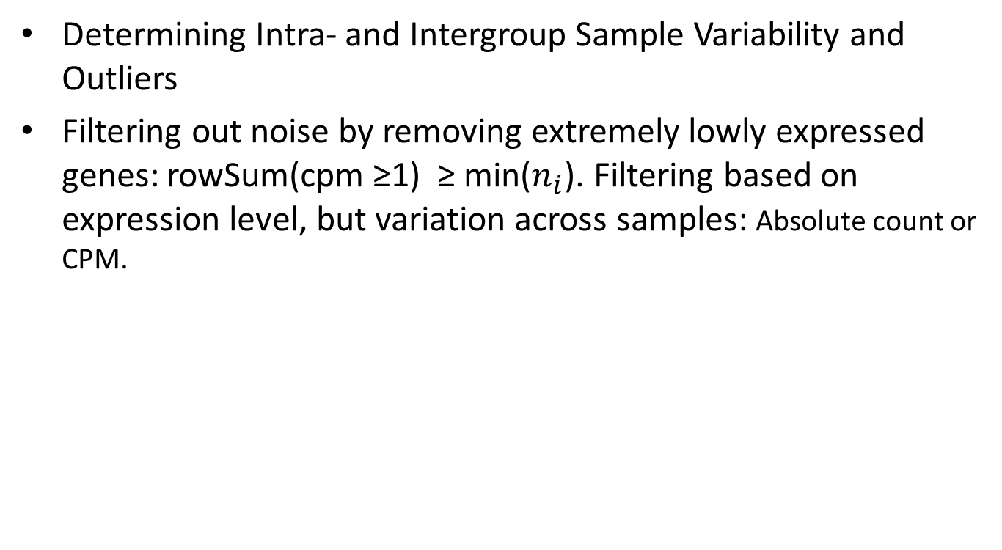
Preprocessing: Filtering
Determining Intra- and Intergroup Sample Variability and Outliers
Filtering out noise by removing extremely lowly expressed genes: rowSum(cpm ≥1) ≥ min($n_{i}$). Filtering based on expression level, but variation across samples: Absolute count or CPM.
log2(count +1)

Slide 49
Preprocessing: Normalization
Normalization methods:
Case 1: Assumption that most genes are not DE is valid
TMM (Trimmed weighted mean)
DESeq (median of log expression ratio)
Case 2: RNA composition dramatically different between conditions
Smooth quantile normalization ( R package: YARN): Tissue-aware normalization
Spike-in based normalization (use only if no other choice)

Slide 50
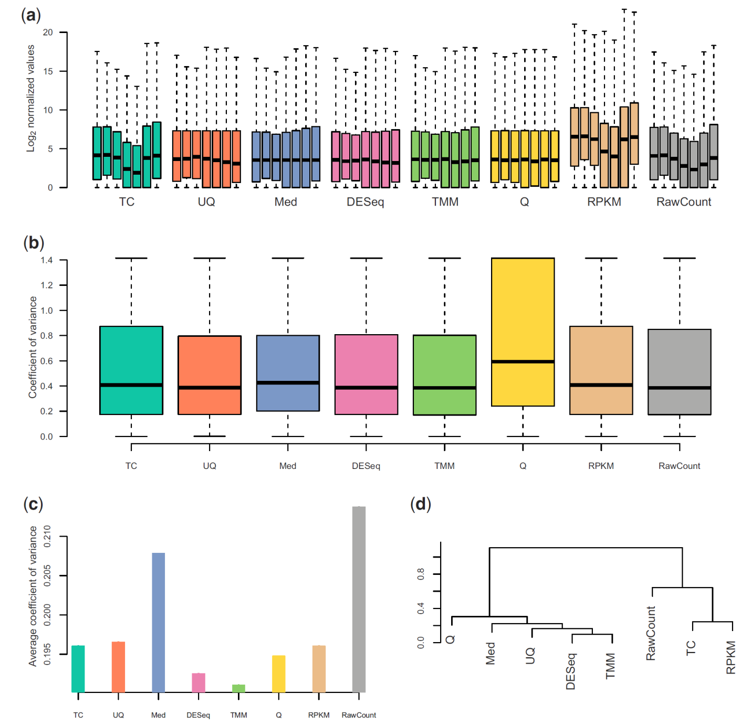
DESeq and TMM normalization methods are the best for Case I
Dillies et al. Briefs in Bioinformatics, 2012 (14)6: 671-683

Slide 51
Read count normalization within samples
● DO NOT use RPKM (Reads Per Kilobase Million) and FPKM (Fragments Per Kilobase Million) to express normalized counts in ChIP-seq (or RNA-seq) ANY MORE!!. (Wagner et al. Theory Biosci. (2012) 131: 281. https://doi.org/10.1007/s12064-012-0162-3; )
● CPM (Counts Per Million) and TPM (Transcripts Per MIllion) is the less biased way of normalizing read counts.
● Watch the video for explanation: https://www.rna-seqblog.com/rpkm-fpkm-and-tpm-clearly-explained/

Slide 52
Outline
Overview of RNA-seq
Experimental design
Data generation
Sample preparation
Library preparation
Sequencing
Data analysis
Sample level analysis
Gene level analysis
Advanced analysis

Slide 53
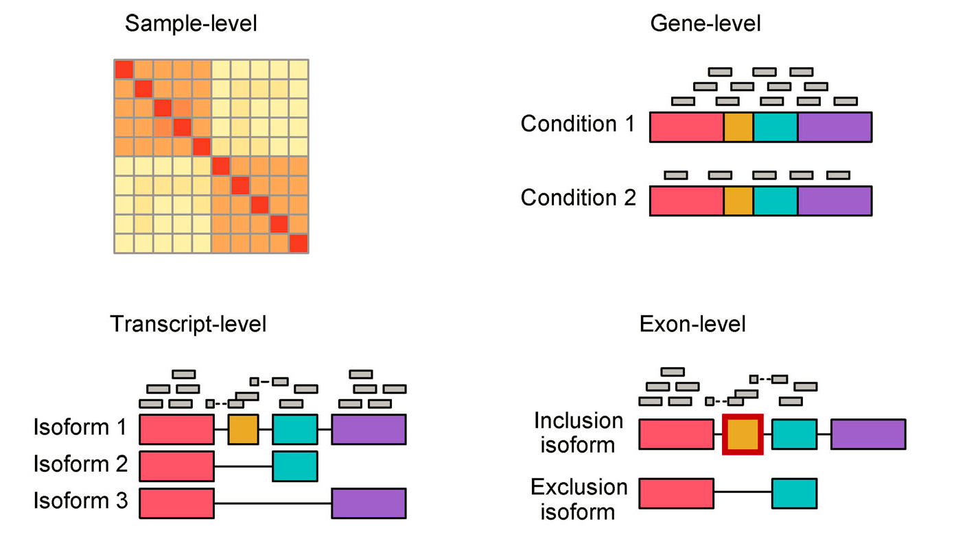
RNA-seq data analysis at FOUR levels
Li and Li. Quantitative Biology 2018, 6(3): 195–209. https://doi.org/10.1007/s40484-018-0144-7

Slide 54
Sample level analysis
Data transformation
regularized log (rlog, DESeq2 package)
variance stabilizing transformation(VST, DESeq2 package)
logCPM (in limma package)
Transcriptome similarity
Correlation:
Pearson correlation coefficients (PCC, linear relationship)
Spearman CC (monotonic association)
Mutual information, …
Transcriptome overlap measure (TROM): robust (Li et al. Stat Biosci. 2017 Jun; 9(1): 105–136.)
Dimension reduction:
PCA, MDS, tSNE, UMAP

Slide 55
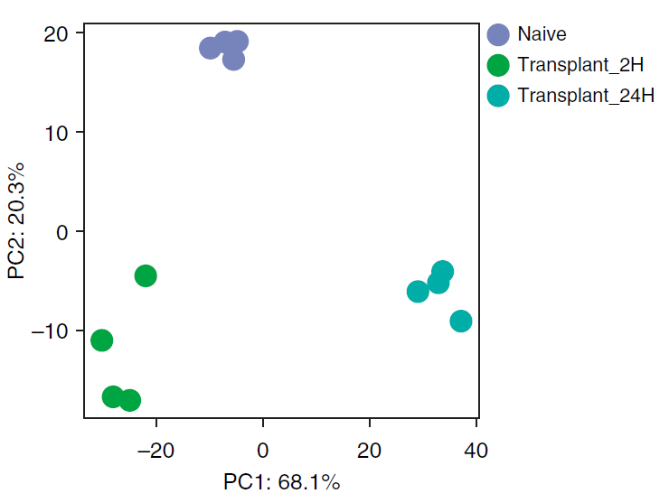
Principal component analysis (PCA)
(Koch et al. Am J Respir Cell Mol Biol 2018(59)2:145–157)

Slide 56
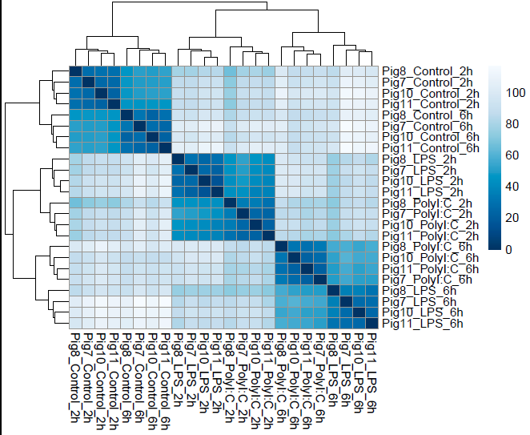
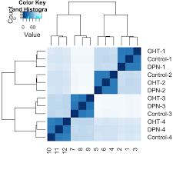
Sample-sample distance plot
Very good
Abnormal (batch effect)
http://pedagogix-tagc.univ-mrs.fr/courses/ASG1/practicals/rnaseq_diff_Snf2/rnaseq_diff_Snf2.html
(Koch et al. Am J Respir Cell Mol Biol 2018(59)2:145–157)

Slide 57



Hierarchical clustering and k-means clustering
(Koch et al. Am J Respir Cell Mol Biol 2018(59)2:145–157)

Slide 58
Outline
Overview of RNA-seq
Experimental design
Data generation
Sample preparation
Library preparation
Sequencing
Data analysis
Sample level analysis
Gene level analysis
Advanced analysis

Slide 59

Approaches for the three types of differential expression analysis (DGE, DTE and DTU)
Soneson et al. F1000Research 2016, 4:1521 Last updated: 12 NOV 2019

Slide 60

Overview of RNA-seq DE analysis
DESeq2
edgeR
limma-voom
(Van de Berge et al. Annu. Rev. Biomed. Data Sci. 2019. 2:139–73)

Slide 61



Statistical modeling and estimation
Using negative binomial (NB) distribution to model count data from RNA-seq
NB generalized linear model for DEG analysis
(Van de Berge et al. Annu. Rev. Biomed. Data Sci. 2019. 2:139–73)

Slide 62

Statistical inference
Test hypotheses:
$H_{0}$: there is no DE between conditions, i.e., that the LFC is zero.
$H_{1}$:the LFC differs from zero.
Test methods:
Likelihood ratio tests (LRTs): DESeq2 and edgeR. LRTs compare the likelihood of a full model, upon estimating all parameters without constraints, with the likelihood of a reduced model, where one or some of the parameters are constrained according to $H_{0}$. LRT statistics are asymptotically χ2-distributed under $H_{0}$.
Wald test: DESeq2 only. W = LFC /se(LFC), asymptotically follows a standard normal distribution under H0
(Van de Berge et al. Annu. Rev. Biomed. Data Sci. 2019. 2:139–73)

Slide 63
Adjusting p-values for multiple testing
False discovery rate (FDR)
Benjamini–Hochberg Correction (BH)

Slide 64
Variations to the General DEG Workflow
Alternativemodels (inference frameworks)
QL method (QuasiSeq, edgeR): F-statistics
limma-voom models: empirical Bayes, moderated t- and F-statistics (Law et al. Genome Biology. 2014, 15:R29)
Nonparametric methods: NOISeq, SAMseq
Robust log-fold change estimation: shrinkage of estimators LFC
Ratios of smaller counts result in more variable LFCs
the estimation of LFC can be sensitive to outliers.
Accounting for unobserved effects
SVAseq and RUVseq
Statistical inference by testing against a threshold.
H0: |LFC| > a (implemented differently in DESeq2 and edgeR)
Small-sample inference: too small number of replicates (Di et al. 2013)
Multiple testing:
Local FDR, Storey’s q-value
(Van de Berge et al. Annu. Rev. Biomed. Data Sci. 2019. 2:139–73)

Slide 65

Variants of differential expression analysis
Differential gene expression (DGE)
Differential transcript expression (DTE)
Differential transcript usage (DTU)/differential splicing (DS)
Differential exon usage
(Van de Berge et al. Annu. Rev. Biomed. Data Sci. 2019. 2:139–73)
For details of statistical models, see Li and Li. Quantitative Biology 2018, 6(3): 195–209. https://doi.org/10.1007/s40484-018-0144-7
(Collado-Torres et al. 2017. https://f1000research.com/articles/6-1558)

Slide 66
Visualization of DEGs

Slide 67

P-value histogram
How to interpret a p-value histogram?
http://varianceexplained.org/statistics/interpreting-pvalue-histogram/
Breheny et al. High-Throughput 2018, 7, 23; doi:10.3390/ht7030023

Slide 68

Volcano plot
R package: EnhancedVolcano

Slide 69

MA plot
M (log ratio) and A (mean average) scales

Slide 70


Venn diagram and upset plot
http://genomespot.blogspot.com/2017/09/upset-plots-as-replacement-to-venn.html

Slide 71
Heatmap
(Koch et al. Am J Respir Cell Mol Biol 2018(59)2:145–157)

Slide 72

Sankey diagram

Slide 73
Functional annotation of DE genes
Gene set analysis
Overrepresentation analysis (ORA)
Gene set enrichment analysis (GSEA)
Pathway analysis
Overrepresentation analysis
Gene set enrichment analysis
Pathway topology analysis

Slide 74
Differences in Pathways and Gene Set
A biological pathway is “a series of interactions among molecules in a cell that leads to a certain product or a change in a cell” (https://en.wikipedia.org/wiki/Biological_pathway).
Types:
Signaling pathway
metabolic pathway
genetic pathway(gene regulatory network)
Common pathway databases: (for details, see García-Campos et al. Frontiers in Physiology, 2015(6):383 )
KEGG (https://www.genome.jp/kegg/pathway.html)
Reactome (https://reactome.org/)
WikiPathways (https://www.wikipathways.org/index.php/WikiPathways)
BioCyc (https://biocyc.org/)
Gene set: a set of genes, ie. an unordered and unstructured collection of genes, with some defined relationship.
GO terms-associated genes
MSigDB
Genes on chromosome 1
…

Slide 75
Over-representation analysis (ORA)
ORA is a widely used approach to determine whether known biological functions or processes are over-represented in an experimentally-derived gene list. Procedures are as follows:
First, a arbitrary cutoff is set to define a list of DEGs: p-values, fold changes.
Then, a background list of genes (universal) is define. Usually, the background is a genes expressed under the conditions of interest.
Then, the DEG list is compared to a gene set to find the number of common genes, given the background list.
The p-value can be calculated by Fisher’s exact test, given the background. (See next slide for statistical explanation).
The p-values are adjusted for multiple testing.
CAUTION: This approach will work when the biological difference is large, but it will not work when the difference is small, but evidenced in coordinated way in a set of related genes. Gene Set Enrichment Analysis (GSEA) (Subramanian et al. 2005) directly addresses this limitation.

Slide 76




Overrepresntation analysis (ORA)
A
B
Background
Gene set
DEGs
Hypergeometric distribution
Hoxa5
Hoxa11
Edn2
.
.
.
.
.
.
.
.
.
.
.
.
.
.
.
.
.
.
.
.
.
.
.
.
.
.
.
Enpp2
$$Enrichment fold=\frac{98}{65}=1.5$$
$$p=1−P(k|n, K, N)$$

Slide 77

Gene Set enrichment analysis (GSEA)
Given a priori defined set of gene S and a ranked gene list L, $H_{0}$: the members of S are randomly distributed throughout L; $H_{1}$: the members of S are not randomly distributed throughout L. Procedures are as follows:
1. All expressed genes are ranked based on log2 (fold change) from high to low.
2. Calculation of an Enrichment Score, the degree to which a set S is over-represented at the top or bottom of the ranked list L
3. Estimation of Significance Level of ES by using permutation test
4. Adjusting p-values for Multiple Testing

Slide 78


Slide 79

Gene Set enrichment analysis (GSEA)
GSEA: subramanian et al. 2005(102) 43:15545–15550. http://software.broadinstitute.org/gsea/index.jsp
GAGE: Luo et al. BMC Bioinformatics 2009, 10:161
GAGE + Pathview Tutorials: https://figshare.com/articles/Tutorial_RNA_seq_differential_expression_amp_pathway_analysis_with_Sailfish_DESeq2_GAGE_and_Pathview/1619655
Comparison of different methods: Mathur et al. BioData Mining (2018) 11:8; Hung et al. Brief Bioinform. 2012 May; 13(3): 281–291; Maciejewski. BRIEFINGS IN BIOINFORMATICS. VOL 15. NO 4. 504 -518

Slide 80
Functional annotation of DE genes
Gene set analysis
Overrepresentation analysis
Gene set enrichment analysis
Pathway analysis
Overrepresentation analysis
Gene set enrichment analysis
Pathway topology analysis

Slide 81

Pathway analysis
Further reading:
Khatri et al. PLoS Computational Biology, 2012(8 )2:e1002375
García-Campos et al. Frontiers in Physiology, 2015(6):383
Reimand et al. Nat Protoc. 2019 Feb; 14(2): 482–517.
minepath.org: Koumakis et al. Nucleic Acids Res. 2017 Jul 3; 45(Web Server issue): W116–W121.

Slide 82



Different representations of pathways
A
(García-Campos et al. Frontiers in Physiology, 2015(6):383)

Slide 83




Different pathway analyses
García-Campos et al. Frontiers in Physiology, 2015(6):383

Slide 84
Pathway Analysis vs Gene Set Analysis: When Should I Use Each?
Pathway anslysis:
when you care about how genes are known to interact
when you want to take full advantage of the sizes and directions of measured expression changes
when you want to account for the type and direction of interactions on a pathway
when you want to predict or explain downstream or pathway-level effects
when you want your results to be based on the most recent knowledge
Gene set analysis
when you are looking for “quick and dirty” answers
when you have arbitrarily defined gene sets
(https://advaitabio.com/ipathwayguide/pathway-analysis-vs-gene-set-analysis/)

Slide 85
Outline
Overview of RNA-seq
Experimental design
Data generation
Sample preparation
Library preparation
Sequencing
Data analysis
Sample level analysis
Gene level analysis
Advanced analysis

Slide 86

Advanced Analysis
IGV
UCSC genome Browser
Further readings about data integration
https://academic.oup.com/bfg/article/17/2/104/4944665
https://www.sciencedirect.com/science/article/pii/B9780444626509000166
Conesa et al. Genome Biology (2016) 17:13

Slide 87


Co-expression network analysis
A
B
Factors contributing to observed co-expr.
Useful tools:
WGCNA
coseq
Further reading:
van Dam et al. Briefings in Bioinformatics, 2018 (19)4: 575–592
Gaiteri et al. Genes, Brain and Behavior. 2014. 13: 13–24
Usadel et al. Plant, Cell and Environment(2009)32, 1633–1651

Slide 88

Beyond DEG and co-expression analyses: Types of gene expression patterns changes between conditions
Gaiteri et al. Genes, Brain and Behavior. 2014. 13: 13–24

Slide 89

Future direction of RNA-seq: long read sequencing technologies
PacBio Iso-seq
Oxford NanoPore technologies: direct RNA sequencing
Zhao et al. Front. Genet., 21 March 2019

